Slide 1
Group – 1 Project Name Advanced Driving School Management System.
Team Lead & Backend Team Lead: Avinash Sitaram Singh
Frontend Team Lead: Ashwini Sharma

Slide 2
Group – 1 (Name and Roll).
Frontend | Backend
1. Ashwini Sharma | 1. Abhishek Mukherjee
2. Bhagyashree Chhatrapati Holkar | 2. Alok Choudhary
3. Anumula Krishnarjun | 3. Avinash Sitaram Singh
4. Bondu Nireekshana Rani | 4.Bayyapureddy Sushma
5. Avula Lakshmi Narasimha Yadav | 5.Bellapukuntla Sai Ganesh

Slide 3
Project Objective:
Create a dynamic and responsive Java full stack web application for Advanced Driving School Management System.

Slide 4
Tools and Technologies
Front-End: Angular
Server-side: Spring Boot.
Back-end: MYSQL, Hibernate.
Server: Tomcat

Slide 5
Background of the project:
This Advanced Motor Driving School Management system can reduce the efforts of human power and wealth very much and ensure driving-training school’s information resource to be utilized effectively. The motor driving trainers must handle several students at a time. This will provide drawback in terms of communicating with students for his or her driving category schedule or test . It is a web-based application for maintaining records of car and scooty training school. It will maintain the record of entire students at driving school. This application automates manual tasks by managing all records of student’s admission, Attendance, vehicles , and trainers.

Slide 6
Module of the Project
1. ADMIN MODULE.
Admin will be able to:
Login to the portal.
Admin can add/remove or even endorse a student.
Edit the details of student like, name, address, Ph. No.

Slide 7
Admin Flow

Slide 8
Use Case Diagram(Admin)

Slide 9
2. Student Module
Student will able to:
Resister to the portal.
Login in into the application.
Search for the packages.
Can see or select the packages on the portal.
Can select the trainer.

Slide 10
Student Flow

Slide 11
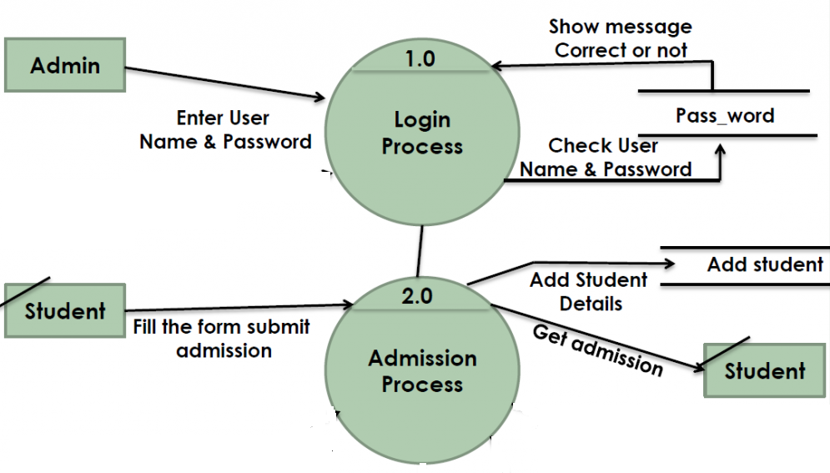
First Data Flow Diagram.

Slide 12
All Frontend Module Name
1. adminlogin | 12. adminlogout
2. admindashboard | 13. studentregister
3. addpackagedetails | 14. studentlogin
4. addstudent | 15. studentdashboard
5. editstudent | 16. viewvideos
6. studentlist | 17. choosepackage
7. packdetails | 18. bookingsuccess
8. editpackagedetails | 19. changepwdstudent
9. changepwdadmin | 20. studentlogout
10. removestudent
11. removepackagedetails

Slide 13
All Backend Module Name
1. Admin Controller | 10. Package
2. Admin | 11. Package repo
3. Admin repo | 12. Package service
4. Admin service | 13. Testing (Automation testing )
5. Student controller | 14. Postman (Function testing)
6. Student
7. Student repo
8. Student service
9. Package controller

Slide 18
Conclusion
This application automates manual tasks by managing all records of student’s admission, Attendance and vehicles.
This Advanced Driving School Management system can reduce the efforts human power.
This helps to increase business.

Slide 19
Thanks For Listing With Great Patience .

